Slide 1
Database Management Systems Lab Lab 1: Introduction to DBMS
Instructor: Dr. Muniba Ashfaq

Slide 2
Course Description
To cover database modeling, design and implementation and to learn how to create a database application.
There are various approaches to designing databases. These approaches are continually evolving.
Relational database is emphasized throughout this lab course.
Databases are implemented on software packages with an emphasis on SQL.

Slide 3
Course Learning Outcomes
CLO-1:Practice and use the technology stack needed to develop and deploy database driven application.
CLO-2: Implement user interface using the knowledge of programming languages and software tools to improve user experience.
CLO-3:Design and build a complete database driven web and/or mobile application for a real world problem.

Slide 4
CLO Assessment Mechanism

Slide 5
Grading Criteria
Lab Reports: 15%
Lab Performance: 15%
Lab Project: 20%
Lab Examination: 30%
Lab Viva: 20%

Slide 6
Course Outline
Introduction to Database Management Systems
Introduction to Dynamic Web Content
Static Web Design using HTML
Improved Web Design using CSS/Bootstrap
Complete Conceptual Schema
Database Development using MySQL
Programming in PHP
Normalized Relational Schema & Basic Database
Interfacing PHP with MySQL
Session on PHP MVC Framework based Database Application Development

Slide 7
Course Outline
Session on Mobile based Database Application Development (Part 1)
Session on Mobile based Database Application Development (Part 2)
Complete SQL Database
Database & Front End

Slide 8
Introduction to Database Management Systems
The database management system consists of two parts.
Database and
2. Management System

Slide 9
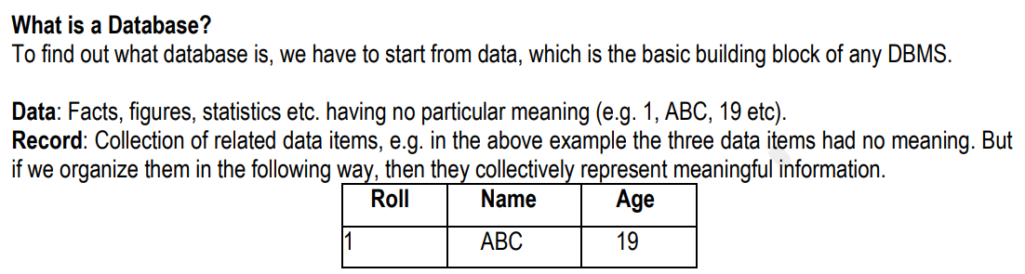

Slide 10
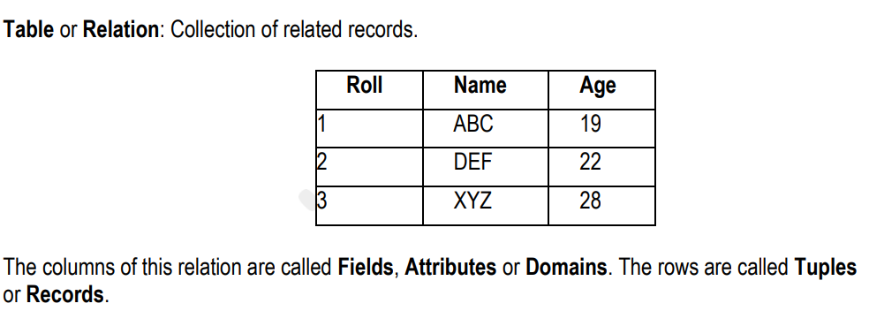

Slide 11
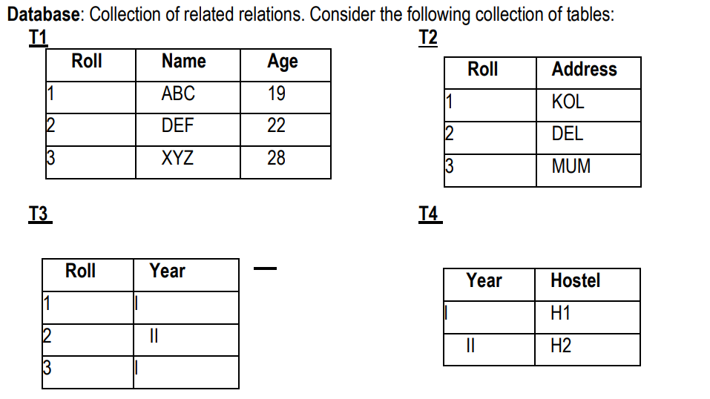

Slide 12
Database Management System
It is a collection of interrelated data and set of programs to access those data.
It is a collection of related data with an implicit meaning and hence is database.
The primary goal of DBMS is to provide a way to store and retrieve database information that is both convenient and efficient.

